Slide 1
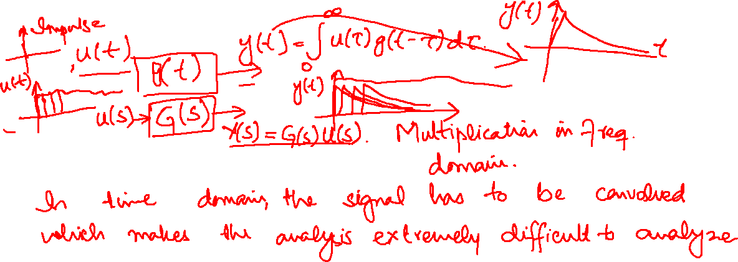
Convolution has to be performed in time domain, while in frequency domain the transfer functions are multiplied, which makes the solution easy. (see the video that is shared in the files section)

Slide 2
Partial Fraction Expansion

Slide 3
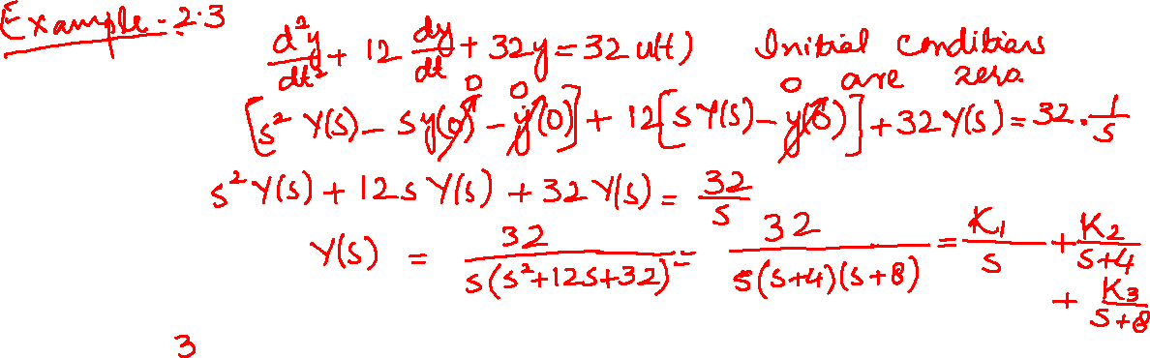
Case I: Roots of denominator of F(s) are real and distinct

Slide 4
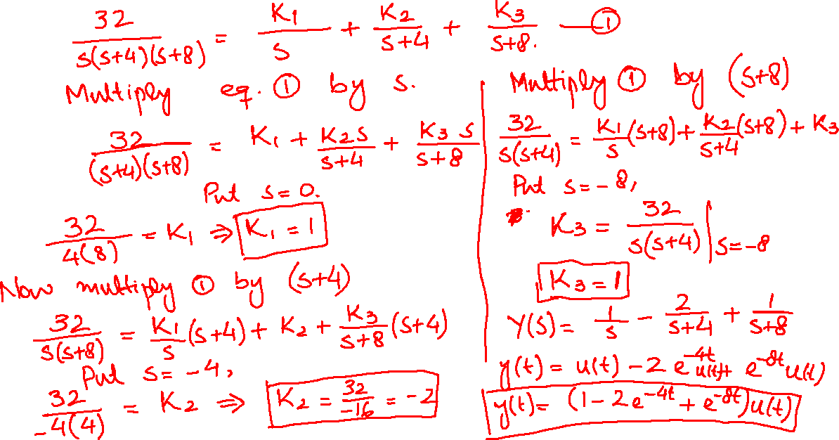

Slide 5
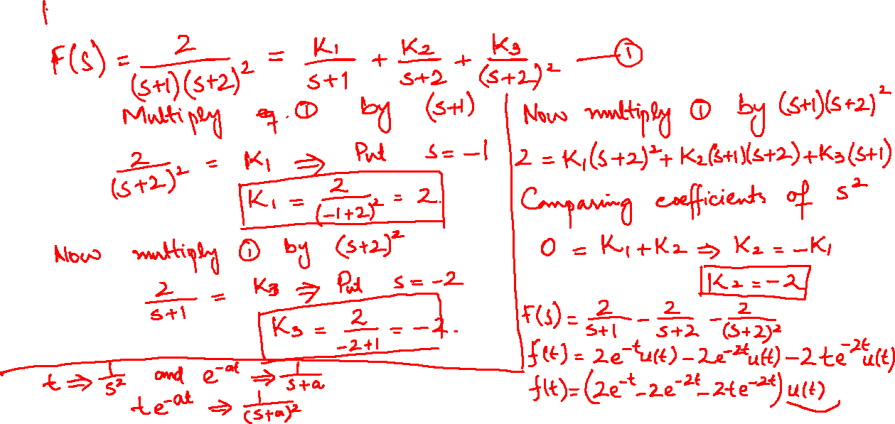
Case II: Roots of denominator of F(s) are real and repeated

Slide 6
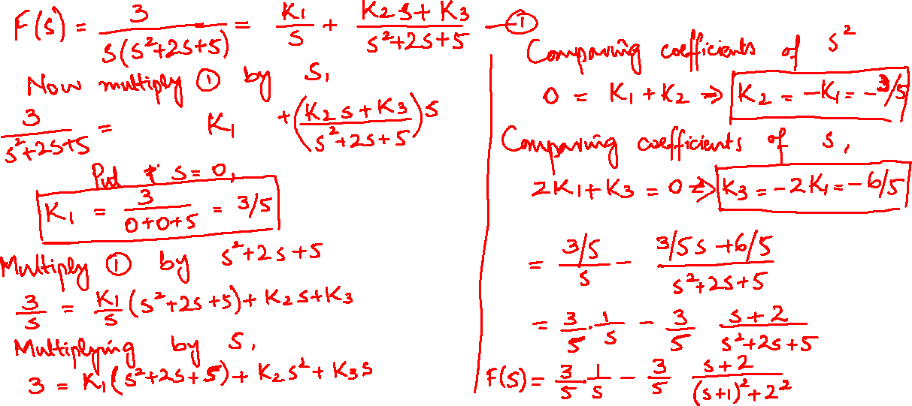
Case III: Roots of denominator of F(s) are complex and imaginary

Slide 7
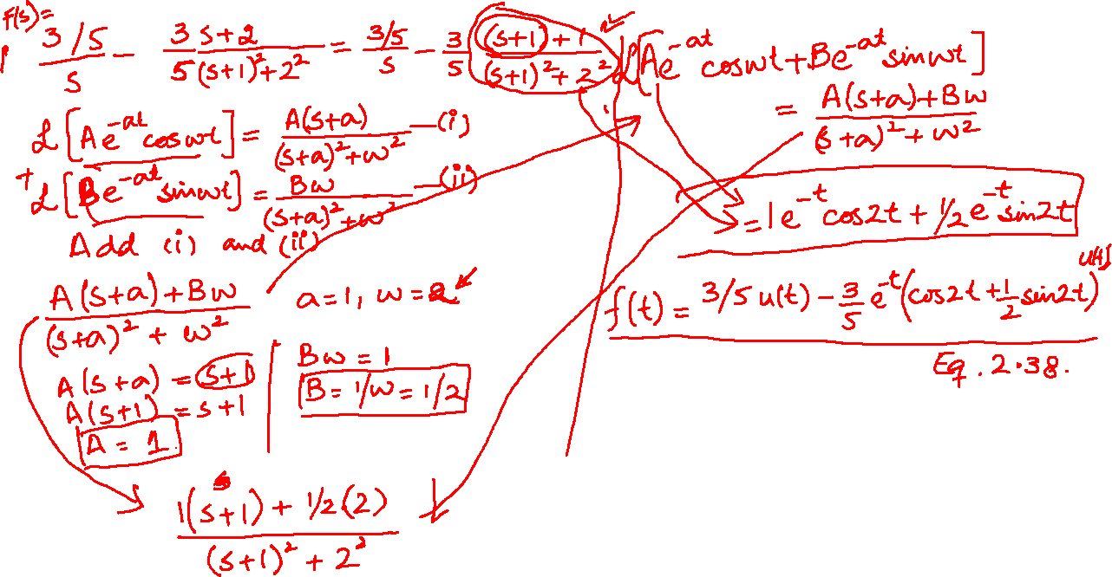

Slide 8
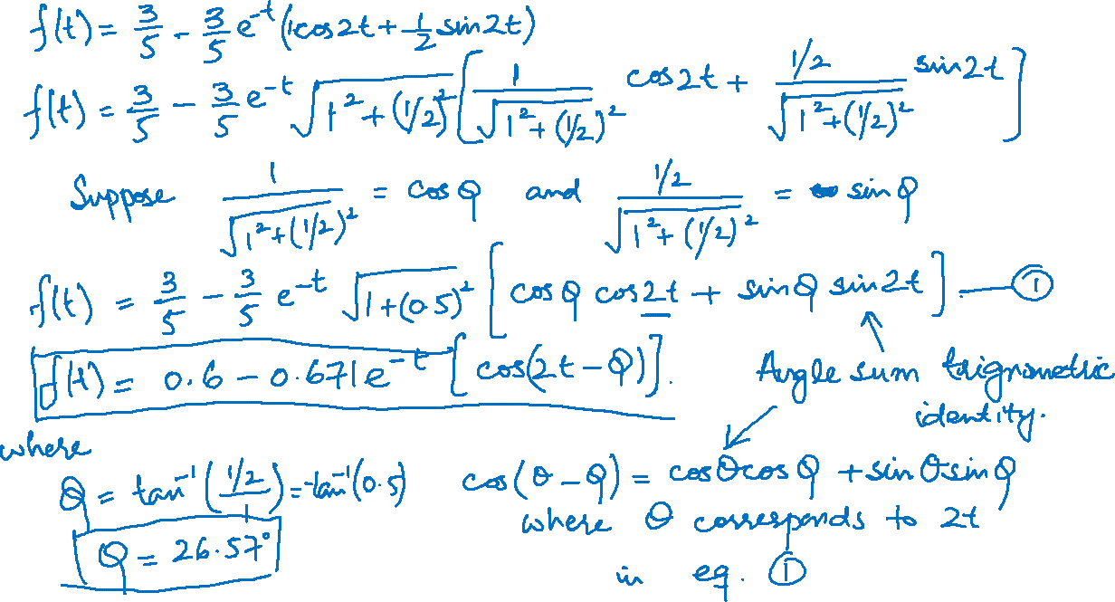

Slide 9
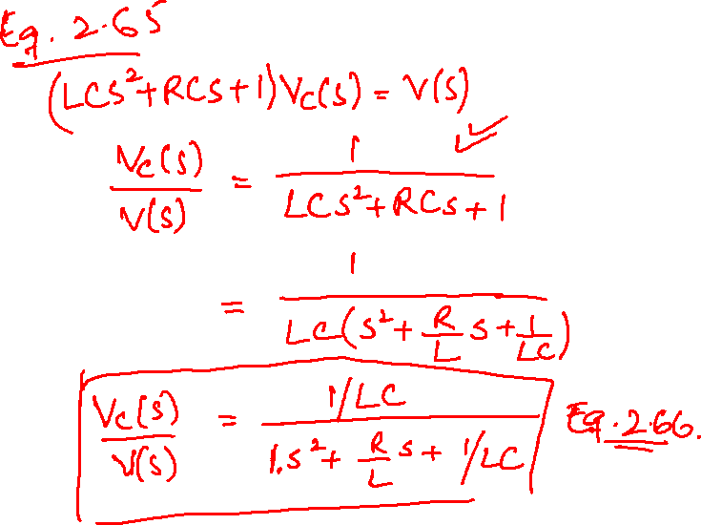
Eq. 2.65 and Eq. 2.66 (it is preferable to make the coefficient of highest power of s (in the denominator of the transfer function) to be 1)

Slide 10


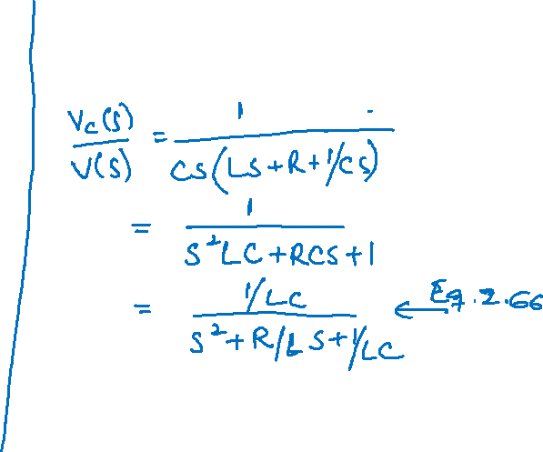
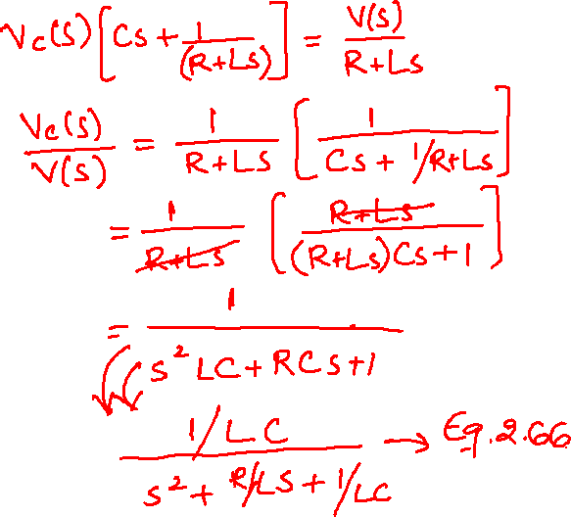

Slide 11
